Slide 1
02 | Components
Jon Galloway | Technical Evangelist
Christopher Harrison | Content Developer
Notes:
Groupings
Labels
Panels
Jumbotron
Objects
Glyphs
Dropdowns
Buttons
Nav
Navbar
Breadcrumbs
Pagination

Slide 2
Bootstrap Components
Over a dozen reusable components built to provide iconography, dropdowns, input groups, navigation, alerts, and much more.

Slide 3
Why?
They look good
Themeable
Replacement for HTML server controls
Great for Ajax / SPA

Slide 4





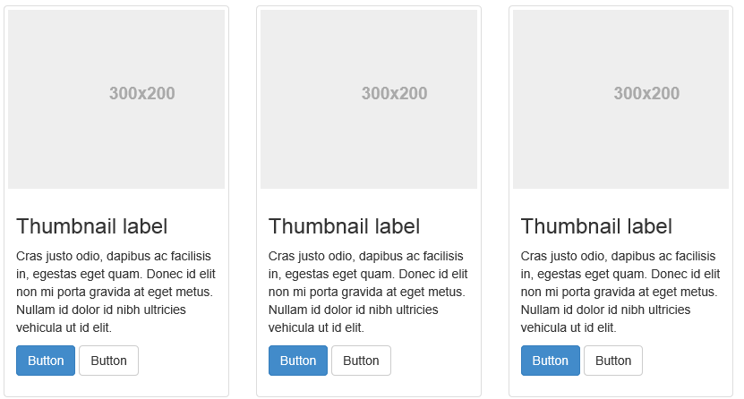
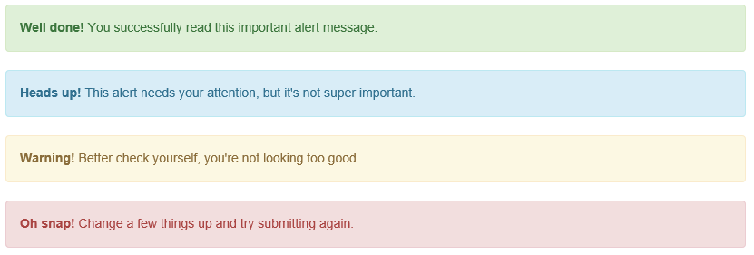
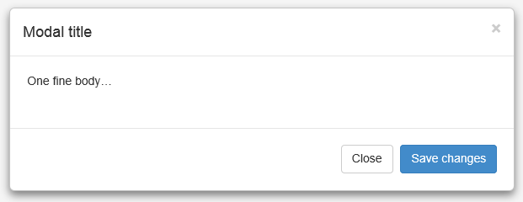
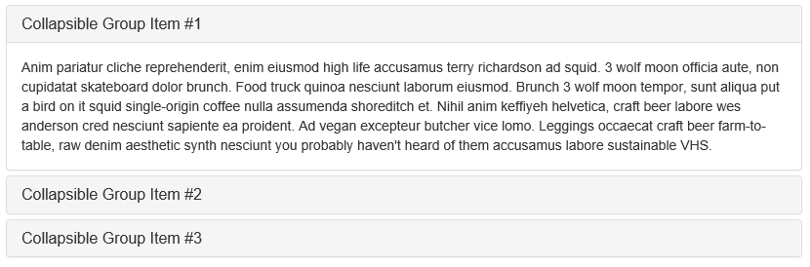
Components

Slide 5
Outline
Grouping
Objects
Navigation

Slide 6
Grouping

Slide 7
Grouping
Jumbotron
Labels
Panels

Slide 8
Grouping Components

Slide 9
Objects

Slide 10
Objects
Glyphicons
Dropdowns
Buttons

Slide 11
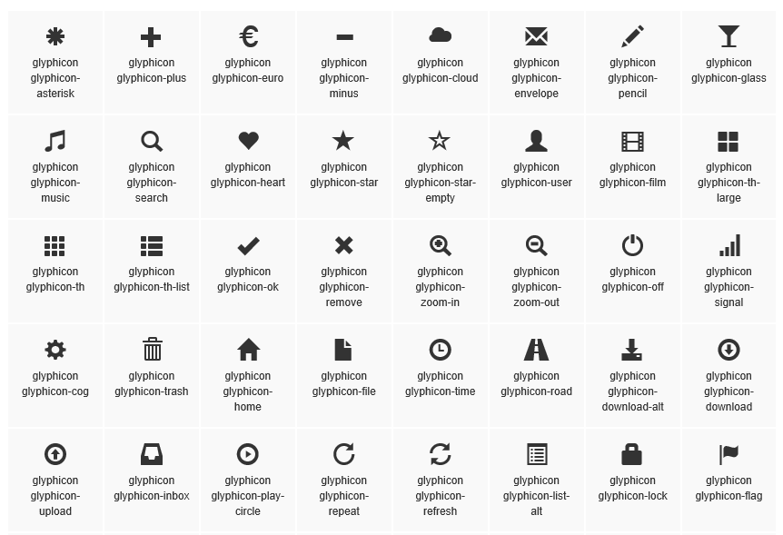
Glyphicons

Slide 12
Who’s got the button?
Use btn to make something look like a button
Use btn-modifier to change the look
Default
Primary
Success
Info
Warning
Danger

Slide 13
Objects: Glyphicons, Buttons, Dropdowns

Slide 14
Enhanced Buttons
Toggle Buttons
Radio button
Checkbox
<div class="btn-group" data-toggle="buttons">
<label class="btn btn-primary active">
<input type="radio" name="shipping" id="ground" checked />Ground
</label>
<label class="btn btn-primary">
<input type="radio" name="shipping" id="two-day" />Two Day
</label>
<label class="btn btn-primary">
<input type="radio" name="shipping" id="overnight" />Overnight
</label>
</div>

Slide 15
Enhanced Buttons

Slide 16
Navigation

Slide 17
Navigation
Navbar
Breadcrumbs
Pagination

Slide 18
Navigation

